Slide 1
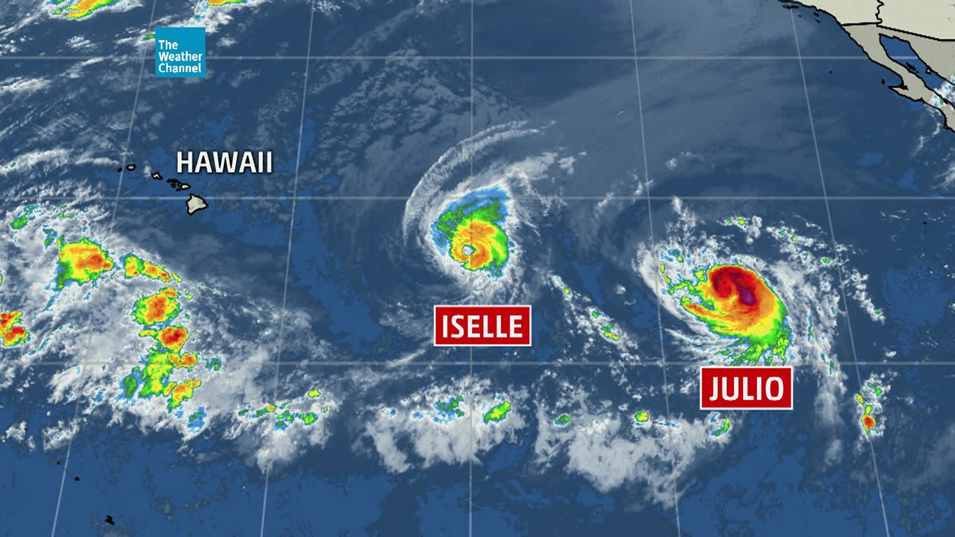
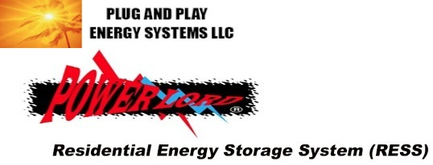
Power When You Need It Most
PlugandPlayEnergySystems.com
Monets001@hawaii.rr.com

Slide 2
ACT 53 amend sections 514A-13.4 and 514B-140, Hawaii Revised Statutes provides boards of directors with the authority to install or allow the installation of solar energy or wind energy devices on the common elements under appropriate circumstances to further reduce Hawaii’s dependence on energy generated from fossil fuels.
Act 201 amends the existing law relating to solar energy devices (section 196-7, HRS) Placement of solar energy devices.
(a) Notwithstanding any law to the contrary, no person shall be prevented by any covenant, declaration, bylaws, restriction, deed, lease, term, provision, condition, codicil, contract, or similar binding agreement, however worded, from installing a solar energy device on any single-family residential dwelling or townhouse that the person owns. Any provision in any lease, instrument, or contract contrary to the intent of this section shall be void and unenforceable.
30% Federal Tax Credit
35% State Tax Credit
Commercial MACRS Depreciation – 6 year
Typical Pay off: * 2 years
AOAO Pass through tax credits to individual owners per their interest in Association
Not Tax or Legal advise, consult with your own tax or legal profession

Slide 3

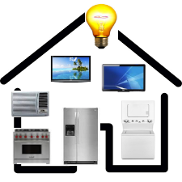
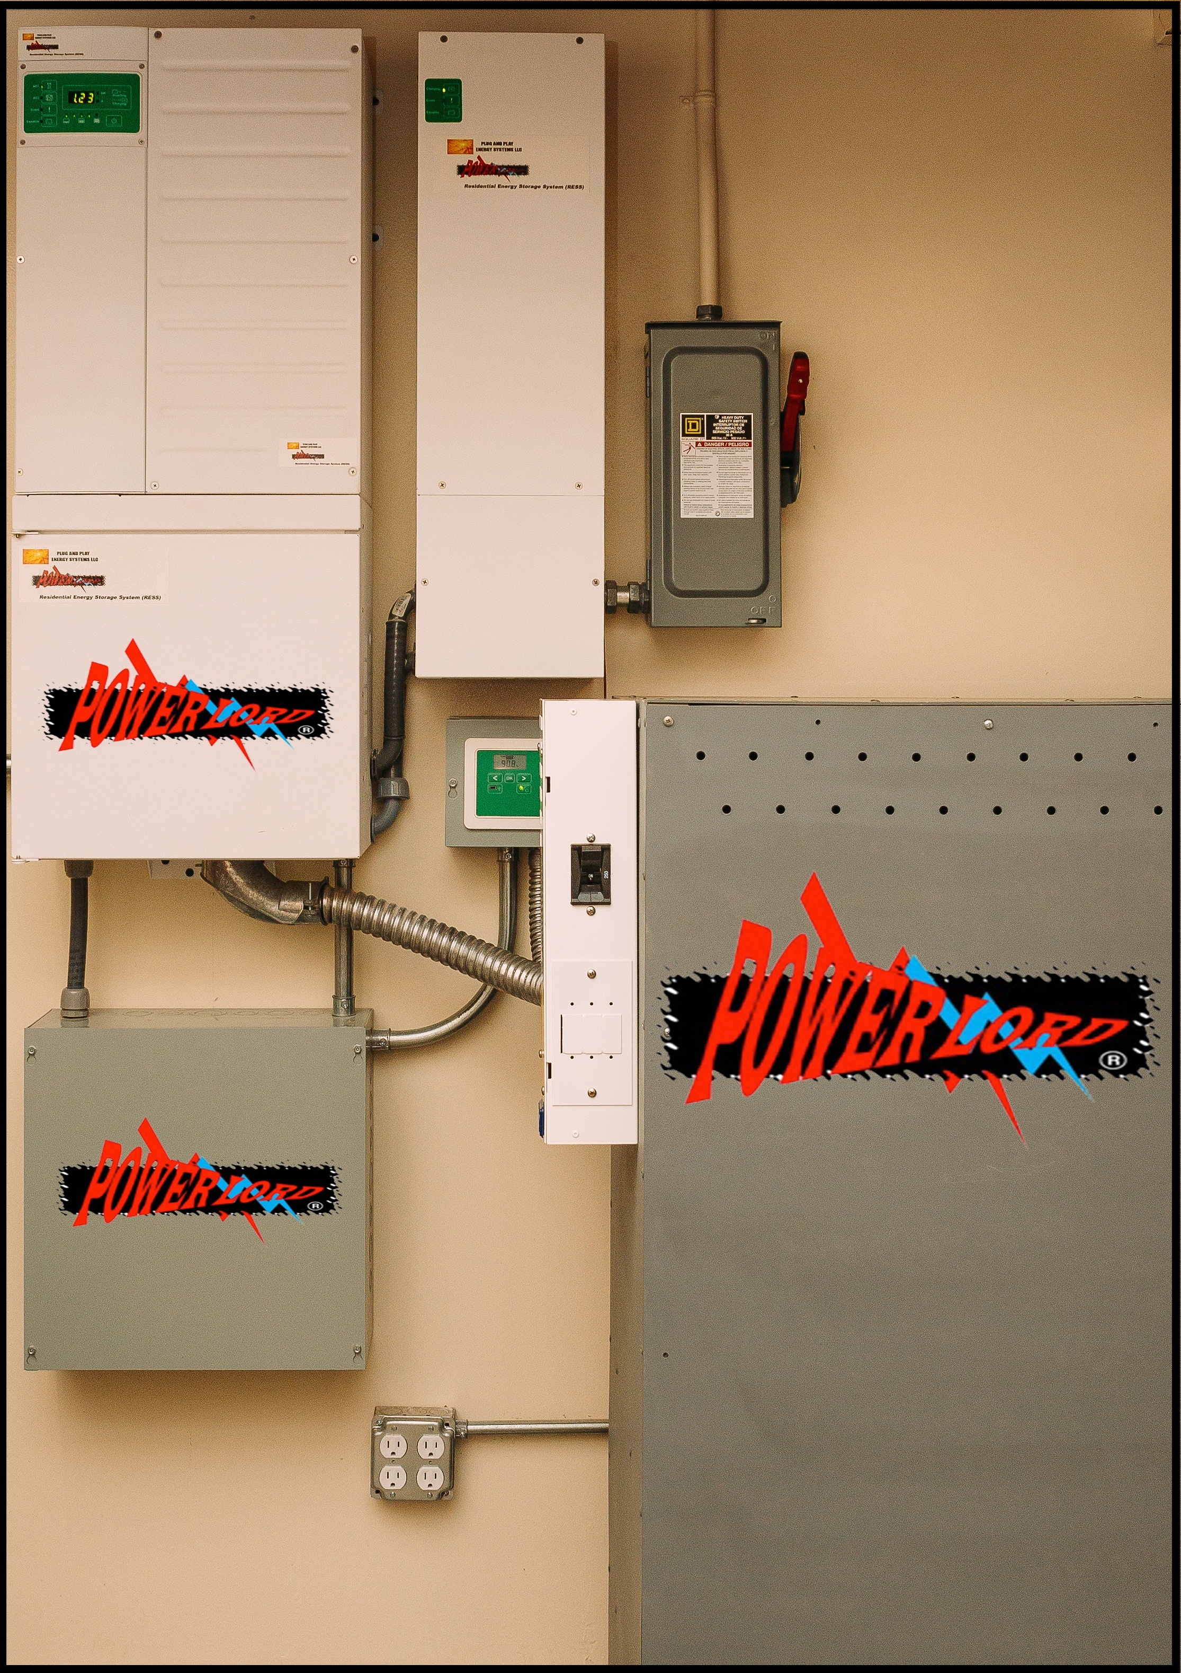
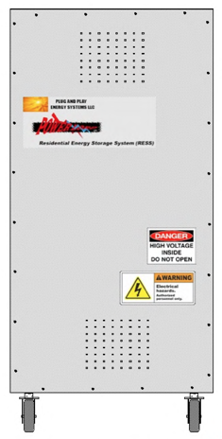
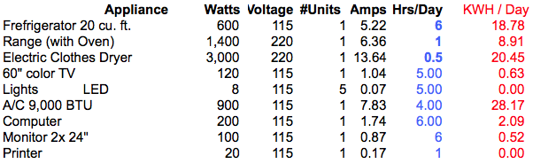
Math
It takes POWER to run modern Appliances
Plug and Play Energy 43.2kwh
8,000watt Continuous Power - 60Amp Discharge

Slide 4

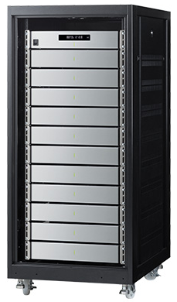
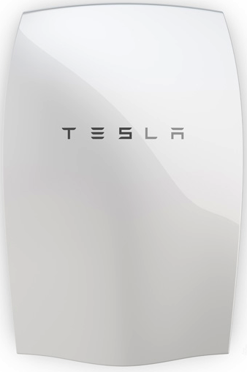
Physics
All Batteries are NOT the same
http://BatteryTestCentre.com.au
Independent, Real Time Tests Indicate that all Lithium Ion Phosphate Batteries Charge and Discharge at only 27% of Rated Capacity
Charge and Discharge at 90% of Rated Capacity
capacity greater than
Plug and Play Energy 43.2kwh
40kwh usable
Blue Ion (Sony) 10kwh
2.7kwh usable
Tesla 14kwh
7kwh usable

Slide 5
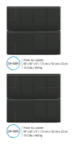
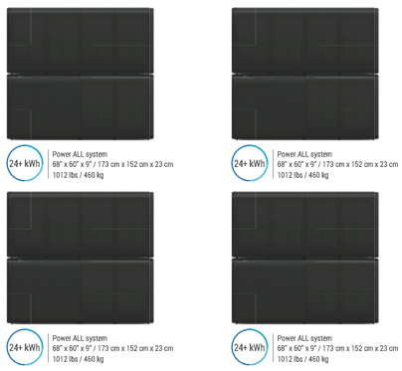
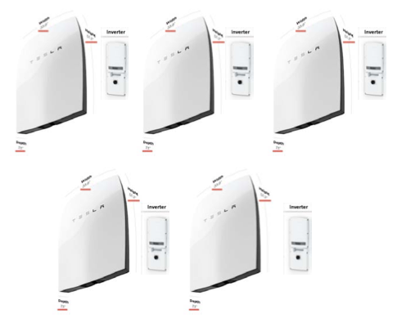
Actual Capacity and Cost
equals
6 Blue Ion 10kwh
equals
PowerLord 43.2kwh
5 + Tesla 14kwh

Slide 6

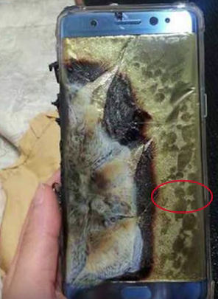

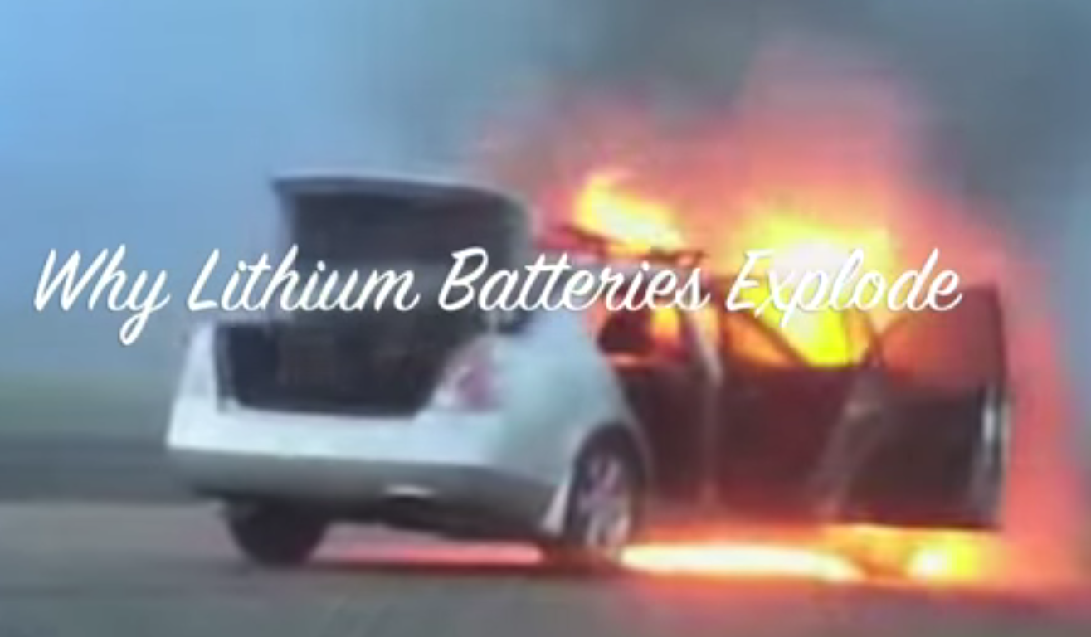
Safety
PPES Battery is Safe for use around People and Pets
There is NO such thing as a Safe Lithium Battery

Slide 7

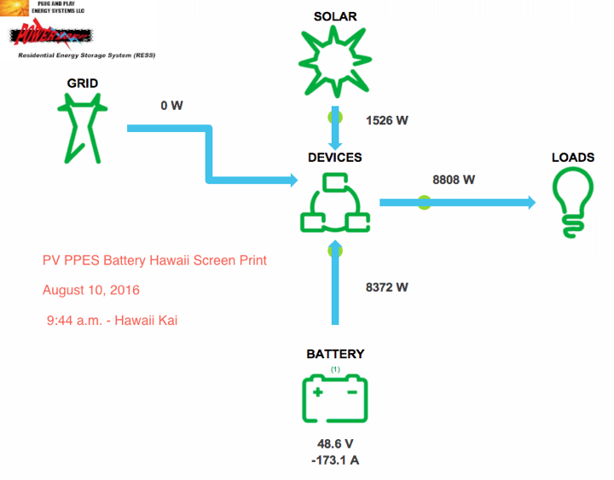

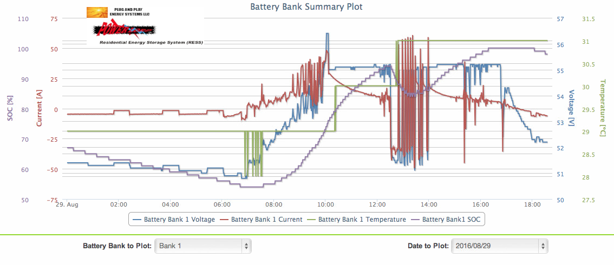
Performance
Rapid Discharge and Charge Rates

Slide 8


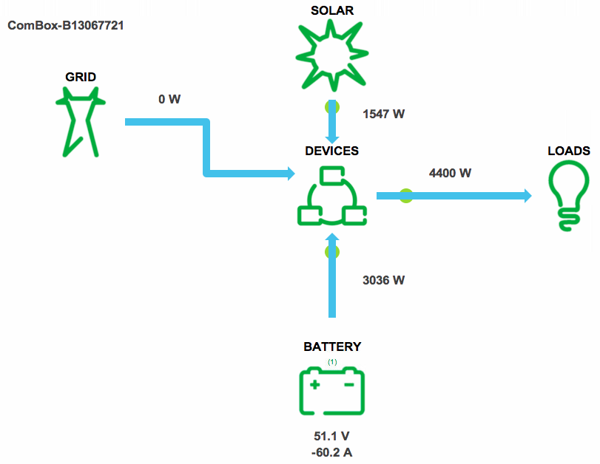
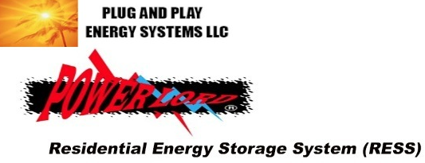
HECO Power Outage
At about 9 a.m. on Nov. 1, 2016 Kaneohe Bay Drive. suffered a HECO outage that lasted for over 1/2 hour.
The Plug and Play 43.2kWh “Wolf” battery storage system connected to a 7.1 kw PV system kept the electric water heater, ice maker, computers, TV, coffee maker, micro wave and much more (8,000w+, -60amps continuous load) operating during the entire outage.
Power When You Need It Most

Slide 9
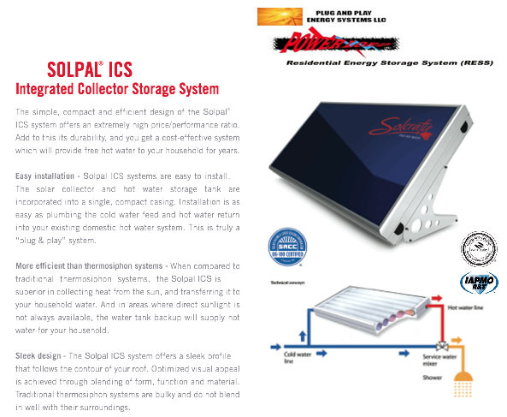


Solar Water Heating
One PPE Solar Panel and one
40-50 gallon tank required
for an average Hawaii home

Slide 10
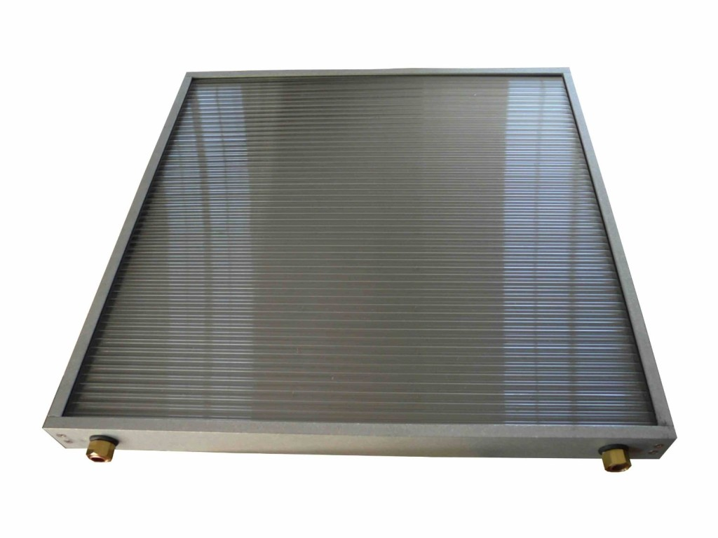
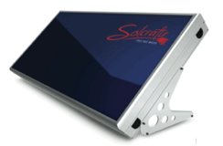
One PPES Solar Water Panel
has the BTU value of 3 conventional solar water panels
equals
One PPES Panel + 50 gallon tank = 100 gallons of hot water

Slide 11
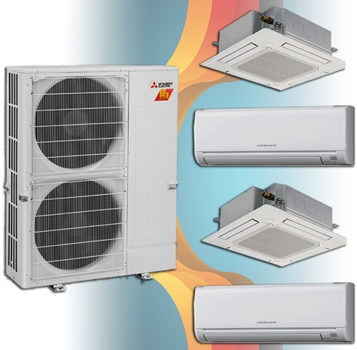
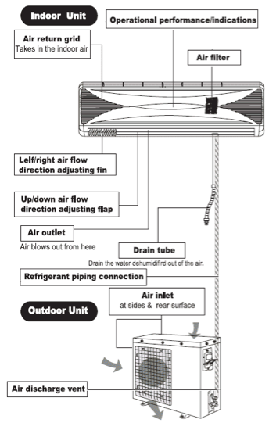
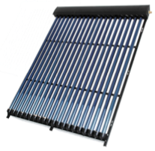


Solar Air Conditioner
48,000 BTUs – 4 rooms
30% Federal Tax Credit
35% State Tax Credit
MACRS Depreciation – 6 year
Typical Pay off: * 2 years
No Battery
No Inverter
PlugandPlayEnergySystems.com
Monets001@hawaii.rr.com

Slide 12
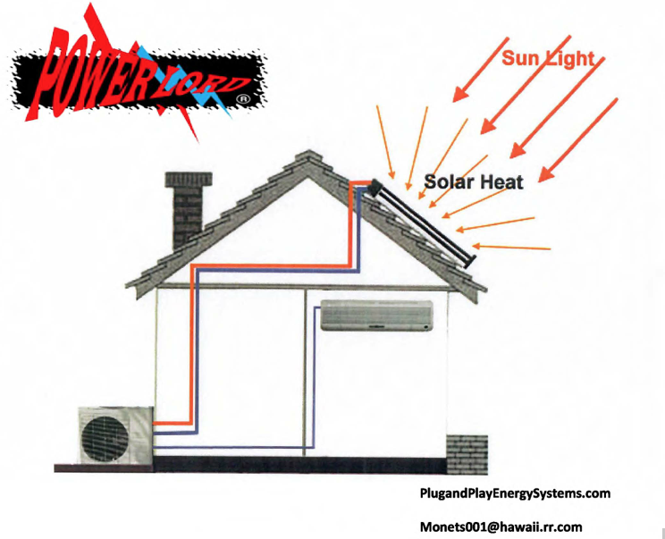

Slide 13
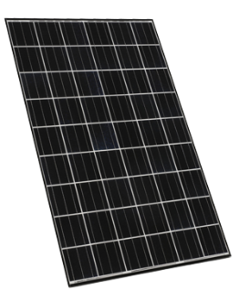
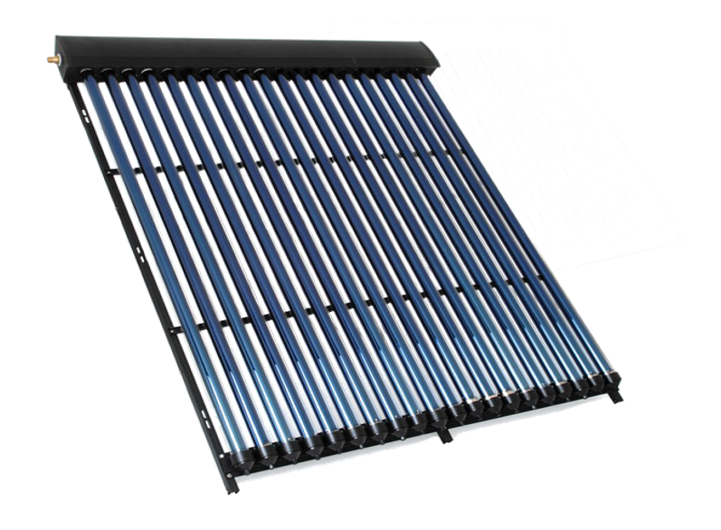

PlugandPlayEnergySystems.com
Monets001@hawaii.rr.com
Thermodynamic Solar Refrigeration can REDUCE OPERATING & ELECTRIC COSTS by 35% and MORE
It is not Solar Photovoltaic (PV)
A battery storage system can further increase AC system efficiencies
=
Notes:
To give you an understsanding of the cost vs. return on investment implications…
13

Slide 14
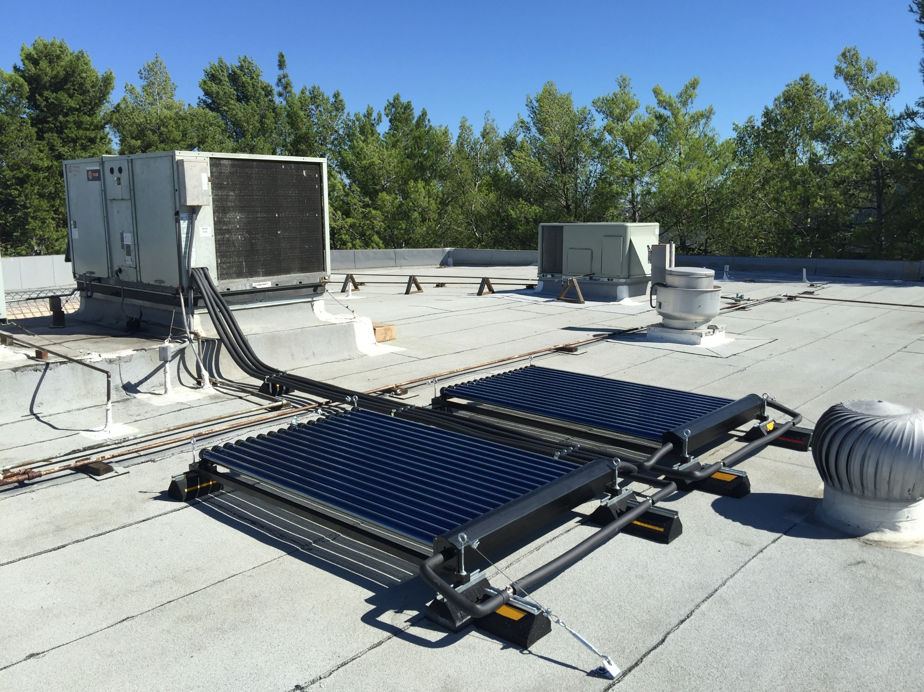
Commercial Retrofit
PlugandPlayEnergySystems.com
Monets001@hawaii.rr.com

